Slide 1


Slide 2

Community Empowerment North Lanarkshire and Scotland – how does it compare to the rest of the United Kingdom?
Presentation by Councillor Jordan Linden Leader of the Opposition (SNP) North Lanarkshire Council

Slide 3

Introduction to the Community Empowerment (Scotland) Act
Aims and Policy Objectives
And
The Act aims to support approaches that can contribute to improving outcomes in all aspects of people’s lives.
Focus on reducing inequalities.
To empower community bodies through the ownership of land and buildings and strengthening their voices in the decisions that matter to them
To support an increase in the pace and scale of Public Service Reform by cementing the focus on achieving outcomes and improving the process of community planning.

Slide 4






Community Empowerment The 11 Component Parts
Part 1: National Outcomes
Part 2: Community Planning
Part 3: Participation Requests
Part 4: Community Right to Buy Land
Part 5: Asset Transfer Requests
Part 6: Delegation of Forestry Commissioners’ Functions
Part 7: Football Clubs
Part 8: Common Good Property
Part 9: Allotments
Part 10: Participation in Public Decision Making
Part 11: Non Domestic Rates
Part 12: General
Notes:
Some of the parts are largely the responsibility of Scottish Ministers – National Outcomes, Forestry Football clubs
Some parts are only relevant to local authority (Non Domestic Rates, Common Good property, etc)
, some parts the local authority have made significant progress with (Asset Tranfer, . Others are more relevant to all public sector partners (these include Community Planning, Asset Transfer, participation requests and participation in public decision making)

Slide 5

NAC - Three Key Areas of Focus
1 - Community Asset Transfers 2 - Community Planning 3 - Participation in Decision Making

Slide 6
1 - COMMUNITY ASSET TRANSFERS

Slide 7

Requirements on the Council
establish, maintain and make available register of land owned or leased by the Council
develop clear decision making criteria and review procedure
actively provide information and promote the process
assess the capacity of the organisation making a CAT request and provide support to assist them to fulfil their aspirations
publish information relating to requests and produce and publish annual reports.

Slide 8

THE NORTH LANARKSHIRE PROCESS

Slide 9
PRE-FORMAL REQUEST
Interested local parties are supported to
consider eligibility criteria.
complete the CAT prequalifying questionnaire.
self-assessment.
Enter into an informal discussion for guidance with a dedicated Community Partnership Team.

Slide 10

SUBMISSION OF A FORMAL REQUEST
A Group can submit a CAT request outlining;
the reason for making the request;
the benefits of the proposal; and
the price they are prepared to pay for the asset.
They must evidence that they meet eligibility criteria: community support
community benefit associated with their proposal
capacity of the organisation to manage the asset and any service

Slide 11

The Council MUST
acknowledge the request and provide information regarding timescales.
The timescale for a decision relating to a CAT request is normally 6 months from validation date.
However the Council can agree a different timescale with the group.

Slide 12

Decision Making
A CAT Assessment Group, made up of key Council officers from across Council services assesses the CAT request.
Assessment report is considered by the CAT Leadership Group to make recommendations to the holding service committee.
Final committee decision.
the Head of Asset and Procurement Solutions is responsible for implementing the full transfer or lease and determining any further property related decisions required to progress.

Slide 13

REVIEW/APPEAL
A CCB can ask for a review or appeal if the Council:-
does not agree to their asset transfer request;
does not decide by the time it should have; and
the CCB does not agree with the terms and conditions in the decision notice.
And a community transfer body has 20 working days to ask for review or appeal;
Those who commented on the asset transfer request must be asked what they think about the review or appeal;
all the papers about the review or appeal must be publicly available online; and
the Council or the Scottish Ministers can ask for more information or undertake further engagement to assist the decision making

Slide 14

Internal Review
Policy and Strategy Committee.
The review must be undertaken by Elected Members.
Must exclude Members from the local area or who have been involved in the initial decision making
Appeals to Scottish Ministers
If internal review does not resolve the issue/if no decision is made within the required period there is right of appeal to the Scottish Ministers.
Appeal to Scottish Ministers can also be made if a request is agreed, but no contract is concluded within the required time limit.
In all cases the final decision lies with the Scottish Ministers. There is no further route of appeal beyond them (except by judicial review).

Slide 15


Current Position
Since April 2020….
3 CAT’s submitted
3 leases approved out with CAT process
3 Groups receiving targeted support working towards CAT
19 Groups in early stage discussions as they have aspirations around CAT

Slide 16


Benefits of CAT
an increased sense of civic pride and local use
attracting additional resource not necessarily accessible to public sector
enhancing the role of communities as delivery partners
the potential therefore to turn liabilities in to assets and problems into solutions
CAT can often be a catalyst to explore other options for empowerment
enhancing the role of communities in the delivery of key priorities

Slide 17

Challenges
current community need/benefit vs longer-term vision
Legislation can be open to interpretation/consistency of approach
competing interests and tensions within a community;
capacity of an organisation, robustness and sustainability of plans - not ‘setting community organisations up to fail’
financial impact versus added social value
managing risk
Resourcing CAT (i.e., capacity building, advice and guidance, property investment, legal process); and
building trusted relationships to allow flexible approaches

Slide 18

Managing the process and planning for the future
CAT is about Community Empowerment
There is an opportunity to consider in the context of the vision and asset rationalisation
A higher number of CAT requests requires
Organisational capacity to support CAT across the Council
an understanding of resource required to support organisations to successfully move through the CAT process at pace

Slide 19
Role of Elected Members
Becoming familiar with the CAT process and policy
promoting an understanding and awareness of policy, process and support available;
Encouraging collaboration
Understanding the resource implications required to deliver and support CAT
ensuring that the CAT process is inclusive, meets the legislative requirements and supports the business of the Council;
Awareness of potential conflict of interest (decision making and review)
Participate in briefings or training opportunities to continue to develop the process and approach

Slide 20
SECTION 1 - KEY MESSAGES ON COMMUNITY ASSET TRANSFERS
CAT can
be complex –process is important
highlight competing priorities within communities and involves a number of key services, organisations and wider stakeholders.
present an opportunity to build trust, collaboration and resource with communities
But ….
The Council has a responsibility to follow process and assess community benefit V potential risk to the organisation, wider and longer-term impact on communities.
A consistent approach is important but each CAT request or enquiry is different, and each must be considered and assessed on its merits.
CAT is one of many tools to support community action, empowerment and ownership
Cost cannot be the only reason for approving or rejecting a request

Slide 21
2 – COMMUNITY PLANNING

Slide 22

LOCAL OUTCOME IMPROVEMENT PLAN
Community Planning Approach. Local priorities identified with communities (Community Boards, Participatory Budgeting, targeted engagement activity etc)
Local investment including Place Planning, Town and Community Hubs and Town visions, Parks Masterplans.
Reflect existing Locality approaches to reducing inequality and improving outcomes (ie employability work, Health and Social care, poverty and deprivation, etc).
Evidence through use of data and intelligence.
Building the capacity and role of communities and the voluntary sector.
Community Safety priorities.
Places, spaces and asset management.

Slide 23


INEQUALITIES
Geographical areas more likely to experience socio economic deprivation.
Current or previous experience of poverty.
Protected Characteristics.

Slide 24

HOW ARE COMMUNITIES EMPOWERED TO INFORM THAT LOCALITY PLANNING PROCESS?
Mix of approaches and methods.
Community Listening events (targeted to those who may not otherwise participate).
Targeted engagement with equalities groups through services
Online survey
Youth engagement
Locality focussed stakeholder sessions
Final endorsement and delivery – Community Boards

Slide 25


WHAT DO YOU HEAR?
Community safety
Access to health services
Mental health and social isolation
Young people
Digital inclusion
Learning from C19 to improve how we work
Funding for community and voluntary sector
Poverty
Access to community and leisure facilities

Slide 26
3 – PARTICIPATION IN DECISION MAKING

Slide 27
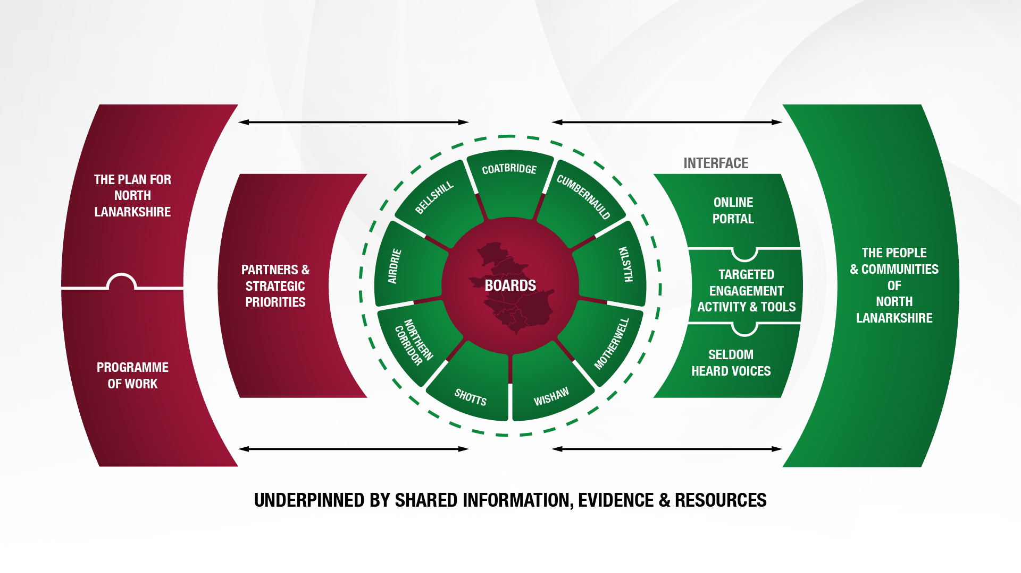
Communities model organised for maximum community input to the vision

Slide 28
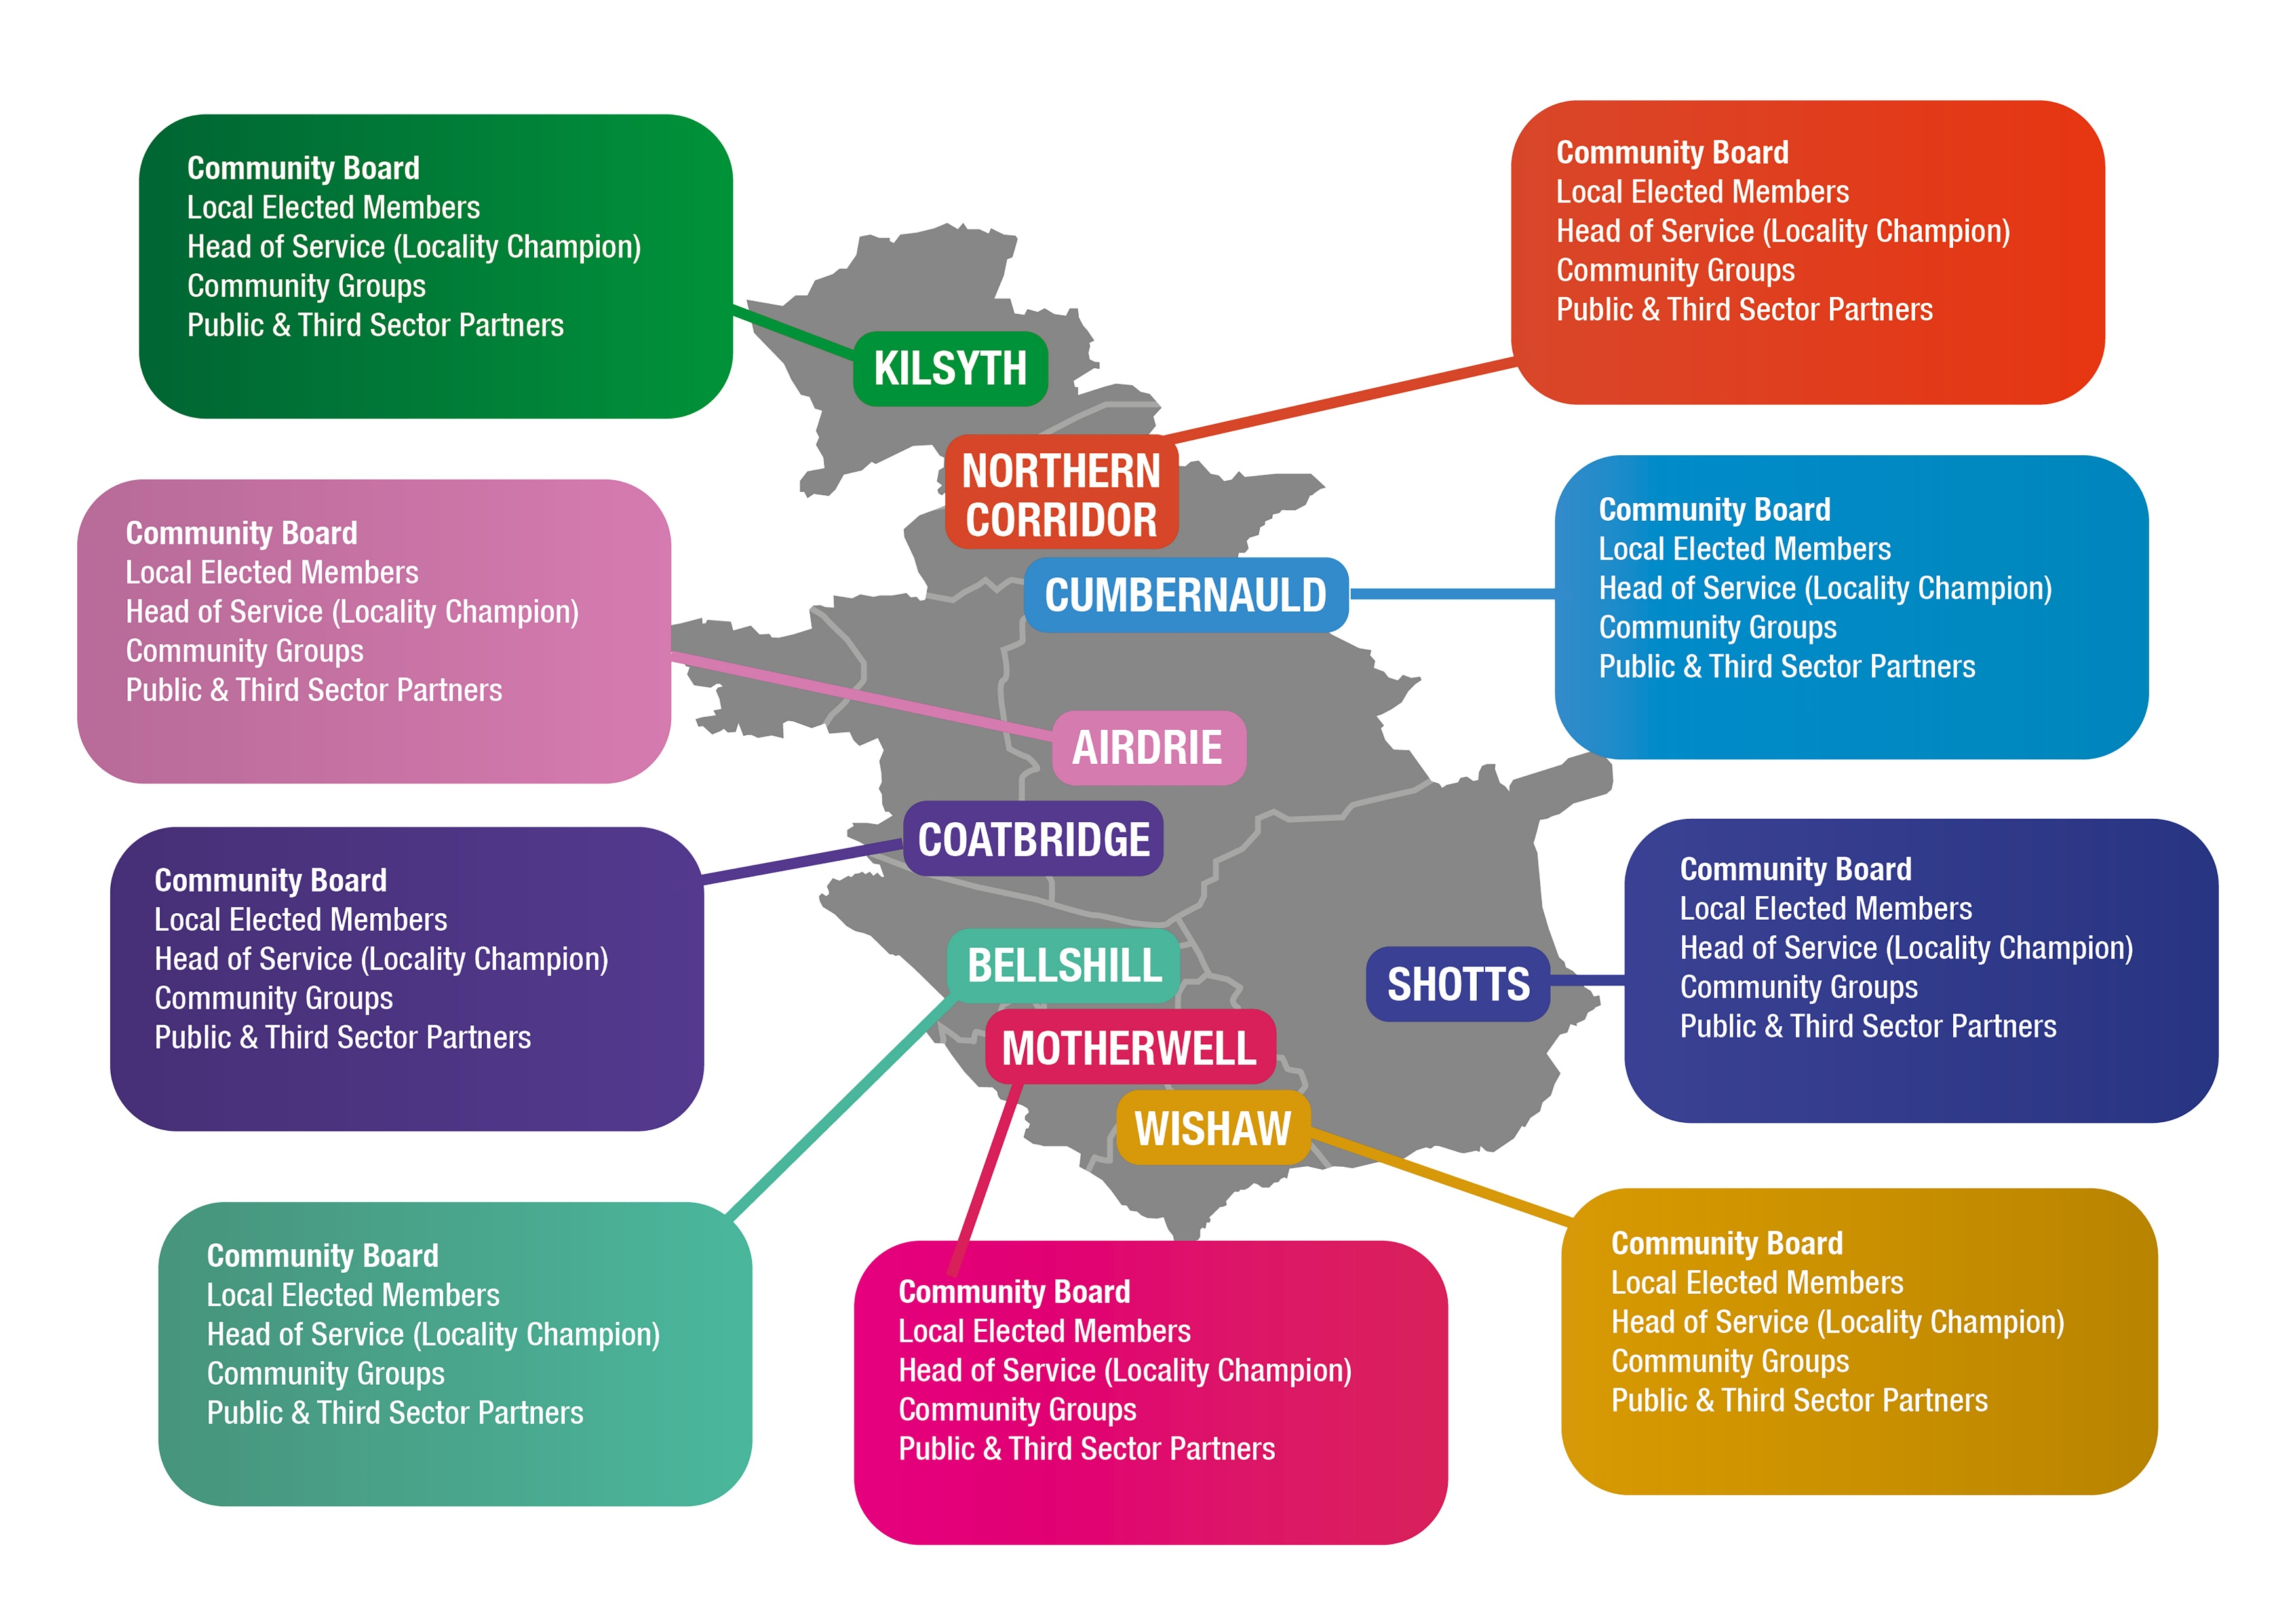
KEEP map and 9 areas but reduce bubbles to 1 as all info the same
ADD section as follows
Communities have been supported to organise across our 9 geographic areas for maximum participation and influence
Creation of 9 Community Boards –
Co-production of 9 priority plans
Assigned 9 senior leaders as Community Champions
9 sets of resource to support communities in the 9 areas -grassroots activity linked to local priorities
Youth participation organised around the 9 areas
Supported by a training and development plan

Slide 29






Supported by…
Wider engagement plans for key parts of TPFNL relevant to a particular area, community of interest or identity
A clear Driving Digital Locally Communities programme
Action and reporting on local plans with a focus on inequality and neighborhoods of highest deprivation
Shift towards ‘honest conversations’ and partnership with communities
Targeted work to ensure the voices of those who are ‘seldom heard’ are listened to

Slide 30
Questions/Discussion

Slide 31


