Slide 1



Emergency Preparedness and Response
Assistant Chief Fire Officer Simon Hardiman

Slide 2


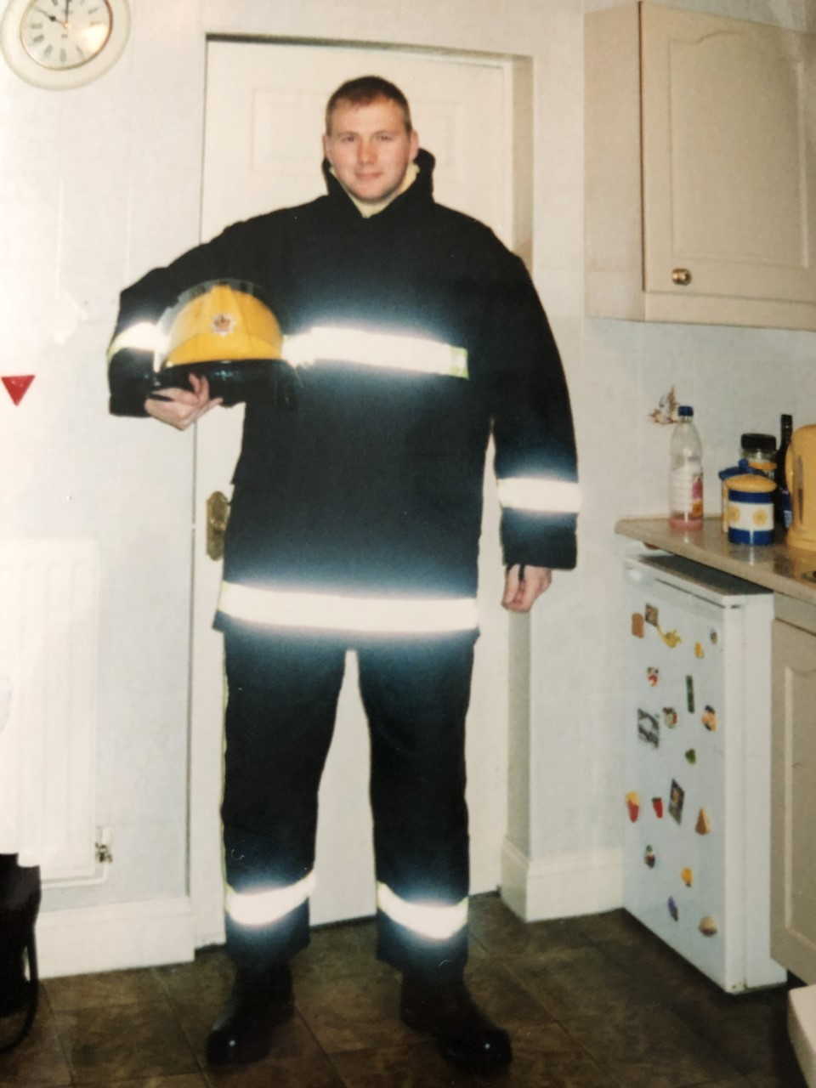
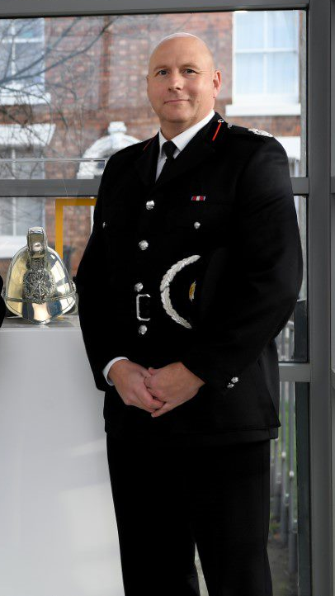
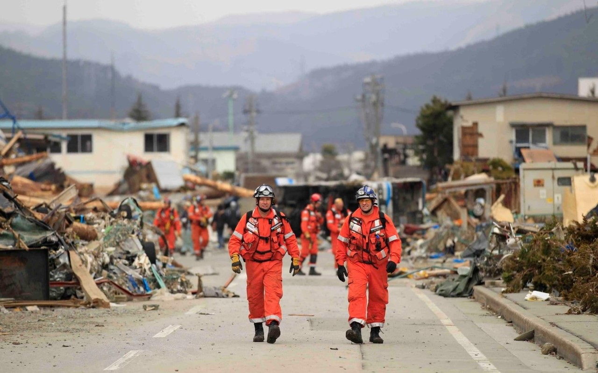
Fire Service Career
Notes:
22 Years service as an Operational Firefighter and Officer, currently serving as ACFO at Shropshire FRS.
Carried out varied roles within 2 Fire and Rescue Services from Operational/ Tactical and Strategic Command and also specialist roles including National Inter Agency Liaison Officer (NILO) and Multi Agency Gold Incident Command (MAGIC accredited)
Experience of managing significant and Major Incidents including fires, floods and industrial accidents.
Worked nationally and internationally as a member of the UK International Search and Rescue Team deploying to Nepal in April 2015 as part of the Government response to the disaster. It was known as the Gorkha Earthquake and resulted in 9,000 deaths and over 22,000 injuries.
I have been involved with the West Mercia Local Resilience Forum for the last 5 years and will talk about the LRF later in the presentation.

Slide 3



Types of Incident
Notes:
Emergency- An emergency is a situation that poses an immediate risk to health, life, property, or environment. Most emergencies require urgent intervention to prevent a worsening of the situation.
Critical Incident- Any incident where the effectiveness of the response is likely to have a significant impact on the confidence of the victim, their family and/or the community.
Major Incident- An event or situation with a range of serious consequences which requires special arrangements to be implemented by one or more emergency responder agencies". They are likely to be larger, more complex, endanger more people or threaten larger areas, and will require additional levels of command, control and co-ordination. This will be likely to involve many emergency services and other responding agencies in a long and high impact event.

Slide 4
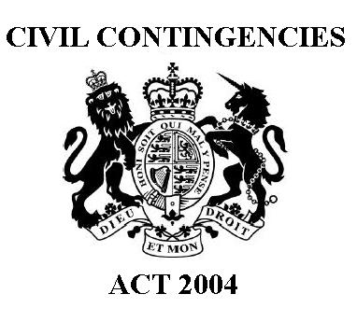
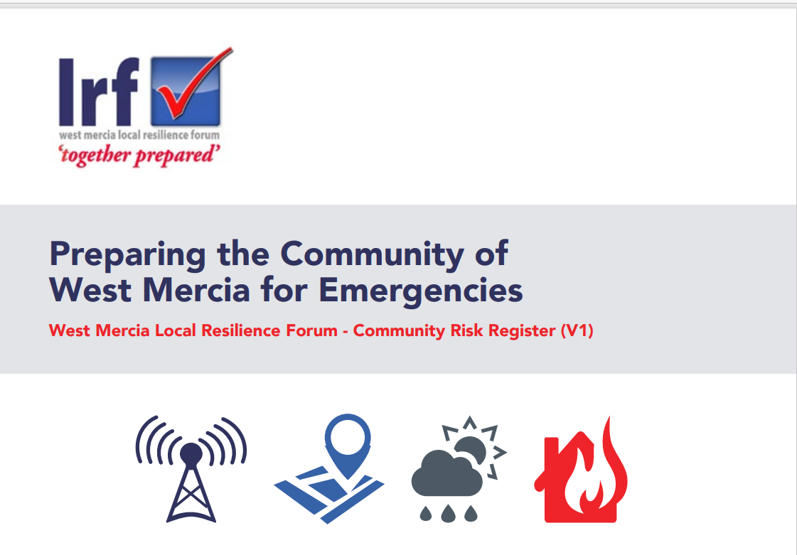
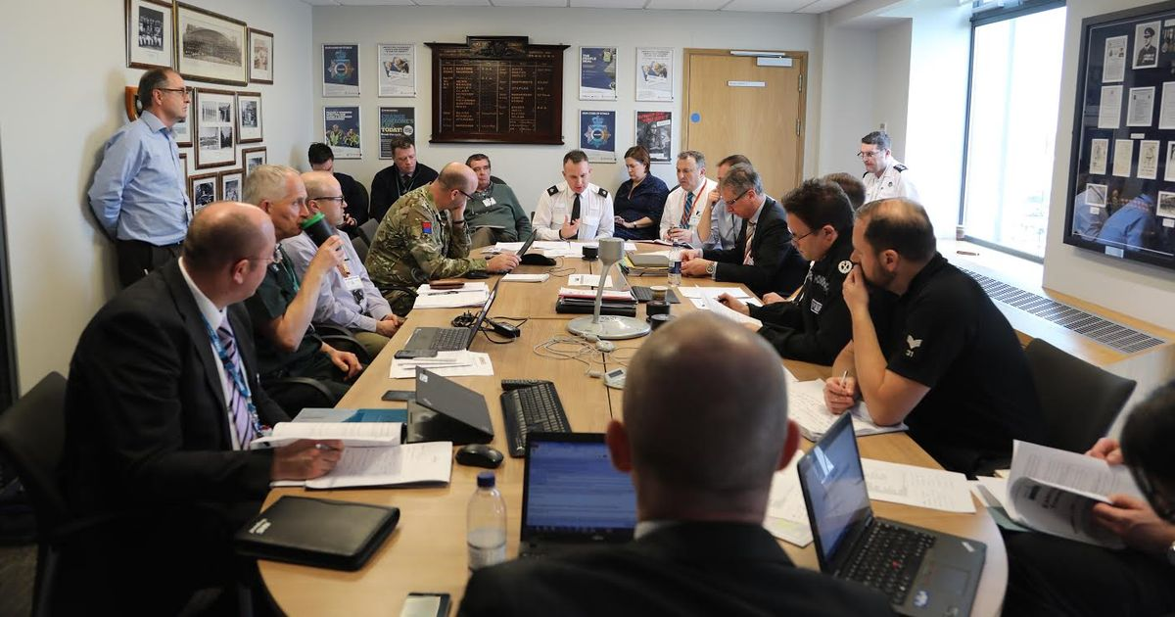
Preparedness
Notes:
Civil Contingencies Act-
Sets out a framework for emergency preparedness in the UK
The CCA and the Regulations state that responders have a collective responsibility to plan, prepare and communicate in a multiagency environment. The LRF provides the environment for preparedness work and also when in a response phase as trusted relationships have already been built.
Local Resilience Forums-
A total of 42 LRFs have been established and serve communities defined by the boundaries of Police Areas across England and Wales.
LRF’s are made up of category 1 responders- Police, Fire , Ambulance, LA’s, Environment Agency and Health partners

Slide 5
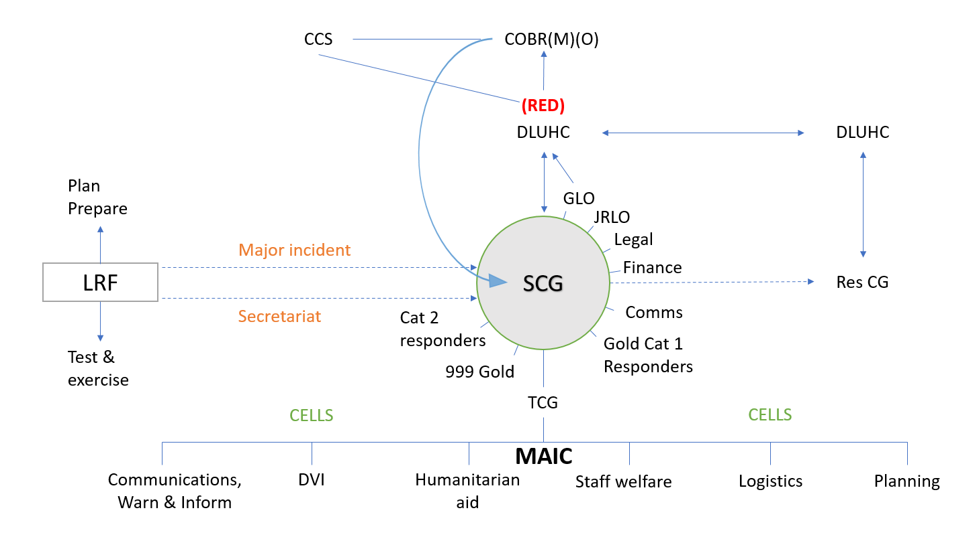
National
Structure
Notes:
As well as the structures for response on the slide, it is critical to establish a recovery cell ASAP to support return to new normality and public confidence.
Discuss the position for Councillors in terms of briefings and where they fit within the structure- Community impact, reassurance, etc
Although Members will not be within the SCG and involved in Operational decision making, there is value in terms of public facing activity as you will be well known within your local communities.

Slide 6

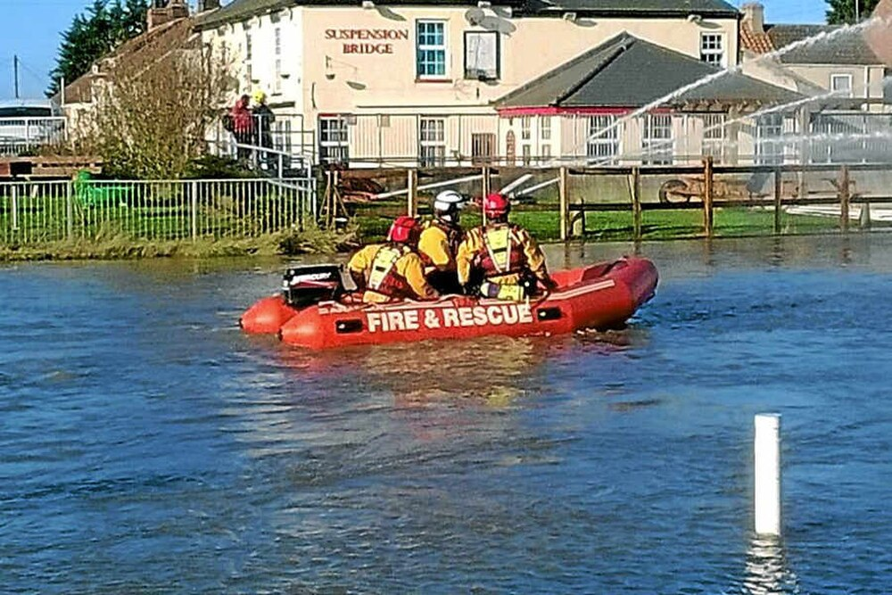
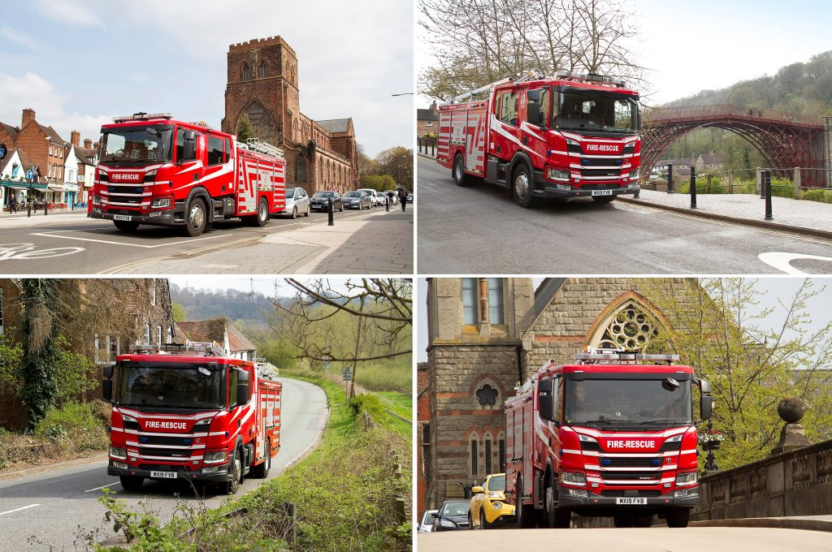
Response
Notes:
Each FRS is required to produce a Community Risk Management Plan and this will determine where resources are best placed to deal with known risk.
Services will ensure the right people with the right skills, training and equipment are located in the best position. This Service Delivery model is what is known as operational workforce and assets. This includes staff, fire stations, appliances, specialist local and national assets such as water, HVP, USAR and DIM capabilities.
When responding to a major incident, the assets can be utilised locally in the first phase followed by regional support and National Resilience Arrangements.

