Slide 1

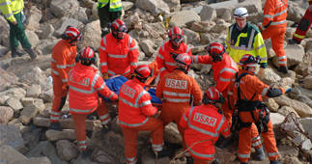
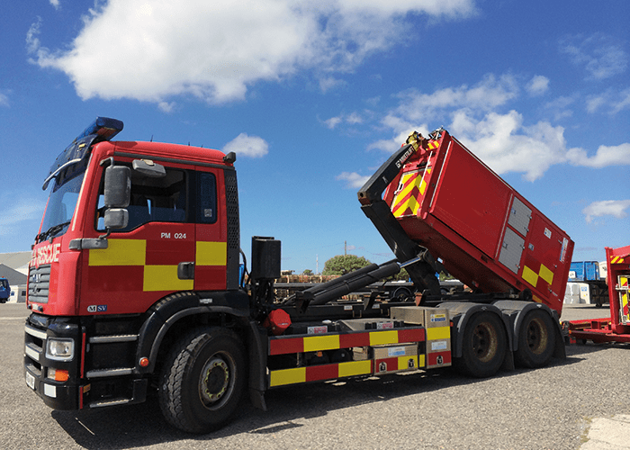

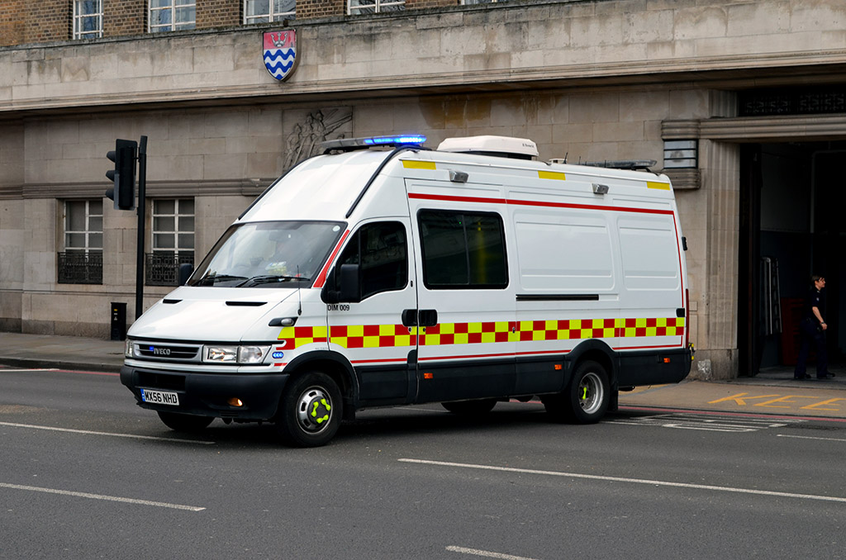
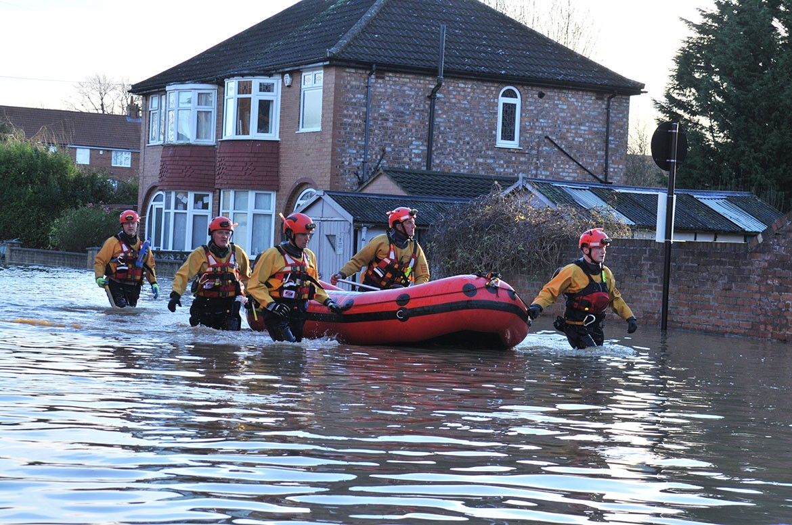

Response
Notes:
National Resilience assets include:
High Volume Pumping Capability
Urban Search and Rescue
Detection, Identification and Monitoring
Water Rescue assets- National boat teams
National Resilience Assurance Team:
Specialist skill sets such as Wildfire, Flooding, Waste Fire, Haz Mat

Slide 2
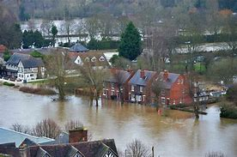
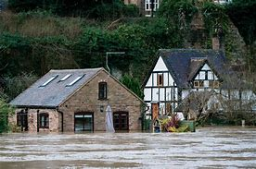
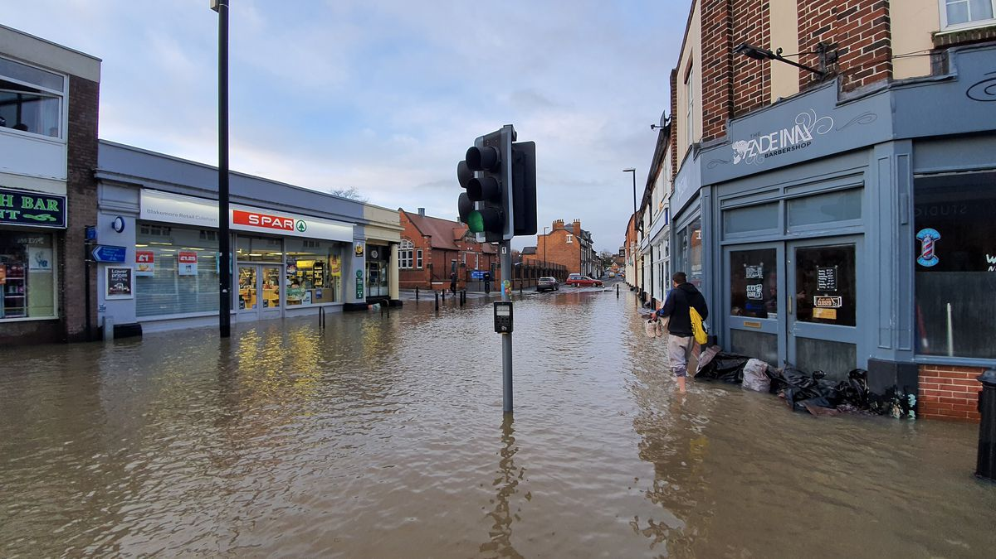
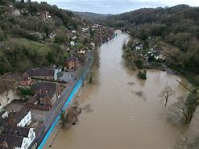
Response in Action
Flooding- February
2022

Slide 3
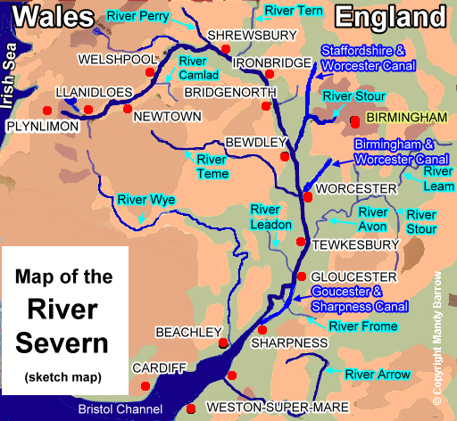
River Severn
Notes:
Severe flooding across the County due to heavy rainfall on the Welsh mountains entering the tributaries of the River Severn which passes through Shropshire.
Information and Intelligence from Environment Agency predicted highest river levels for 20 years.
Risk was overtopping of river defences and barriers in Shrewsbury and Ironbridge.

Slide 4
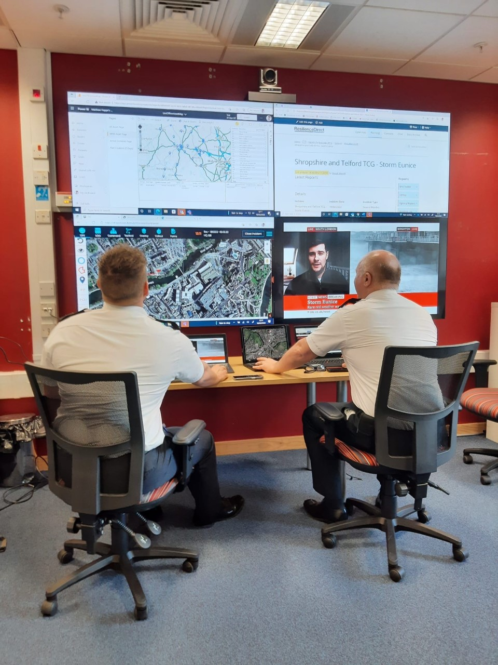
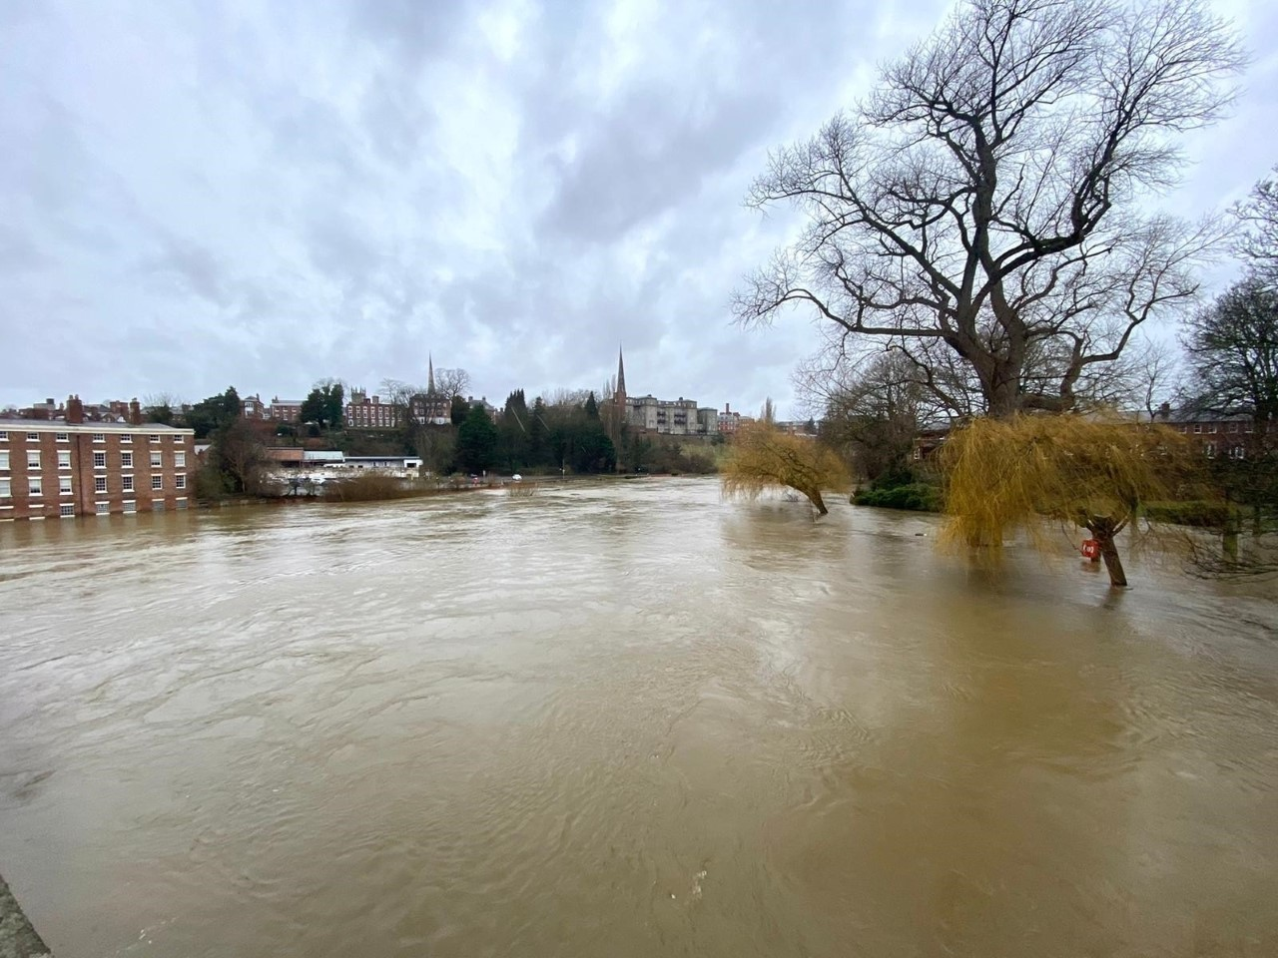
https://twitter.com/i/status/1496487369901498373
https://twitter.com/i/status/1496162756852133896

Slide 5
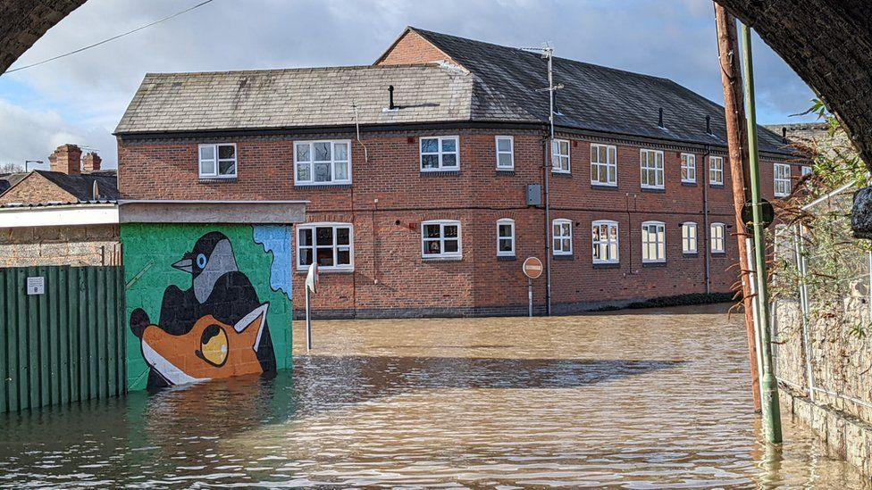
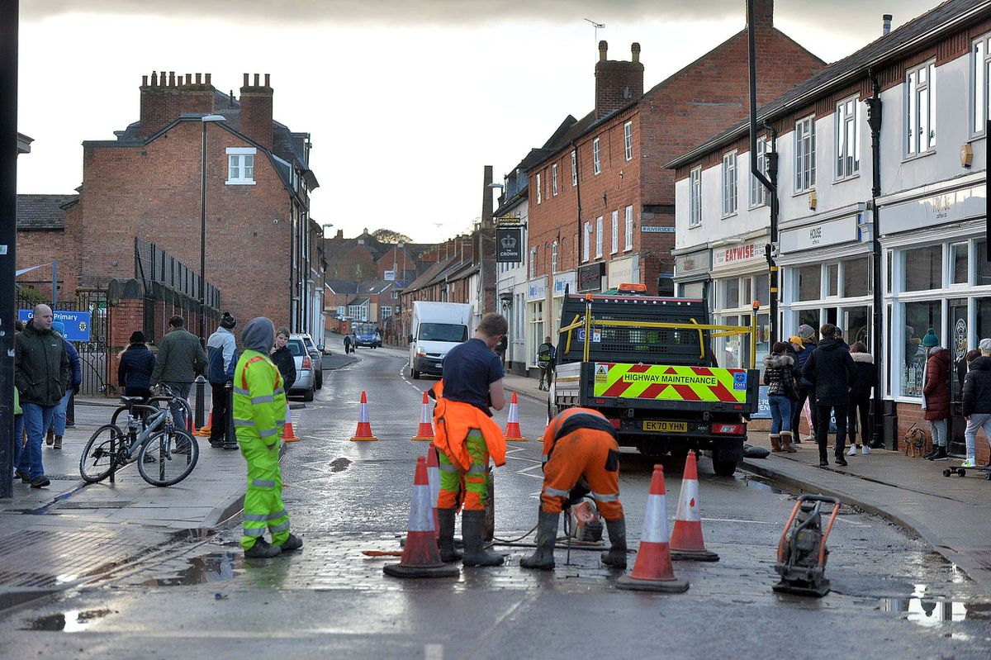
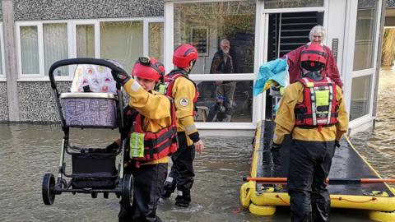
Notes:
Large part of Shrewsbury Town Centre and surrounding areas were underwater leading to communities that were isolated and routes that were impassable.
Major incident declared which triggers a multi agency response through the LRF in Shropshire, Herefordshire and Worcestershire (West Mercia area)
SCG and TCG’s established to co-ordinate the response
Multi agency silver and bronze facilities established to support deployment of assets locally
Request for National water assets to support Fire Service response- Boat Crews from West Mids, North Wales, Mid and West Wales and Surf Rescue Association (Volunteer organisation).
The response phase of the incident lasted 6 days
Recovery is ongoing and this is the critical element where public confidence and reassurance can be affected.

Slide 6


Questions?
Thank You

